Slide 1
Cyber Awareness:
Role of Industry and Government
Presented by
Steve Lines
Chairman, DSIE
Director of Information Assurance, SAIC
October 8, 2010
Cyber Ethics, Cyber Safety, and
Cyber Security Conference

Slide 2
Where it all Started
1983 Fred Cohen invents the first “Virus” University of Southern California
1988 First widely used Anti Virus Software Produced by Alan Solomon
1988 First “Worm” created. Robert Morris released the Morris Worm that infected 10% of the Internet at the time, 6,000 machines
1988 DoD created CERT CC in response to the Morris worm crippling the Internet for days
1990 Eugene Spafford at Purdue University coined the term “Firewall”
Mid 1990’s SSL and HTTPS were created to add encryption and authentication to Internet Protocols
2002 Microsoft halts all programming for a month to retrain programmers and examine old programs for vulnerabilities
Today
  Establishment of the NCSD, NCCIC, NCIRP, Cyber Commands ; DoD recognizing Cyber as a new domain, Network Security Information Exchange, Defense Security Information Exchange, GFIRST, etc

Slide 3
Cyber Threat Environment
Political Inspired Attacks
  Terrorism
  Nation State Attacks
  Destabilization
Economic
  Identity Theft
  Blackmail
  Bank Account Attacks (Organized Crime)

Slide 4
Cyber Threat Environment
Social Networking
  Identity Theft
  Blackmail
  Surveillance
  Cyberstalking
  Child Pornography
Legal
  Regulatory Requirements
  PII, PCI, HIPPA Data Standards and laws etc

Slide 5
The Disappearing Boundary
The perimeter has vanished.
  The risks now extend outside traditional network defenses.
Mobile Devices
  Your mainframe in your pocket!
Cloud Computing
  Computing outside the boundary
Teleworking
  Mixing home with work
Social Networking
  Web 2.0

Slide 6
State of Readiness
Symantec 2010 Critical Infrastructure Protection Study *
The threat of an attack is real
Industry is a willing Partner with Government
  90% have engaged with their Country’s CIP program
There is Room for Readiness Improvement
  Only 1/3 of companies indicated they were prepared for an attack
To Ensure Resiliency Government and Companies should:
  Develop and enforce IT policies
  Protect information
  Authenticate identities
  Manage systems
  Protect the infrastructure
  Ensure 24x7 availability
  Develop an information management strategy
Governments should:
  Make Resources Available to Industry
  Partner with Industry Associations

Slide 7
Anatomy of an Attack:
The Advance Persistent Threat
On September 13th, a Defense Company discovered a critical “0” day vulnerability in Adobe’s Flash product. This issue was reported to US-CERT as well as Adobe.
On September 17th, 2010 several Defense Security Information Exchange (DSIE) members began seeing a dramatic increase in the number of targeted phishing attacks.
The number of attacks reported to the DSIE from member companies increased on September 20th and September 21st to over 20 per day.
The number of attacks for two days resulted in over 25 pages of different attack vectors and over 200 separate indicators

Slide 8
September 21, 2010
The following is a raw data dump of attacks the DSIE members have seen over the past two days.
First indication:
9/17/2010 - US Government Programs to Pay Medical Expenses
getkys phish from 9/17
==Message Headers==
attachment: Beneficial medical programs.pdf
attachmentsize: 382360
Received: from source ([xxx.xx.xxx.xx]) by xxxxxxxx.postini.com ([xx.xx.4.10]) with SMTP; Fri, 17 Sep 2010

Slide 9
September 21, continued
Received: from vznit170060 ([unknown] [xxx.xx.xx.132]) by xxxxx.mailsrvcs.net (Sun Java(tm) System Messaging Server 7u2-7.02 32bit (built Apr 16 2009)) with ESMTPA id <xxxxxxxxx@vms173013.mailsrvcs.net> for xxxxxx@med.xx.com; Fri, 17 Sep 2010 03:57:26 -0500 (CDT)
Received: from xx.xxx.xx.53 ([xx.xxx.xx.xx]) by vznit170060 (Verizon Webmail) with HTTP; Fri, 17 Sep 2010 03:57:04 -0500 (CDT)
Date: Fri, 17 Sep 2010 03:57:04 -0500 (CDT)
From: CENTERS FOR MEDICARE & MEDICAID SERVICES <xxxx@verizon.net>
To: xxxxxxx@yahoo.com
Message-id: <xxxxxxxxxxxxxxx.JavaMail.root@vznit170060>
Subject: US Government Programs to Pay Medical Expenses
MIME-version: 1.0
Content-type: multipart/mixed; boundary="----=_Part_2522407_869451767.1284713824487"
X-Originating-IP: [xx.xxx.xx.xx]

Slide 10
Analysis of Attack
Name: Beneficial medical programs.pdf
MD5 :832dbd816b0b08878bd332eee299bbec4
Size: 32360
==Attachment Analysis==
===Dropped Files===
ISSNIP_2010.pdf contained:
File: eparty.exe
MD5: 0ade988a4302a207926305618b4dad01
Size: 37888
File: clip.exe
MD5: 0ade988a4302a207926305618b4dad01
Size: 37888
File: eparty.dll
MD5: 68f5a1faff35ad1ecaa1654b288f6cd9
Size: 27649

Slide 11
Analysis of Attack, continued
When executed, svchost.exe creates:
File: /Documents and Settings/iaops/Local Settings/Application Data/msupdater.exe
MD5: fd5dffebd39e9aca4f79107b6889699d
Size: 49152
File: Documents and Settings/iaops/Local Settings/Application Data/FAVORITES.DAT
MD5: 1491e39ca13db315820d37fb6972e160
==C2==
https://www.xxxxxxxx.com/asp/kys_allow_get.asp?name=getkys.kys (xx.xxx.xxx.xxx)
Size: 40960

Slide 12
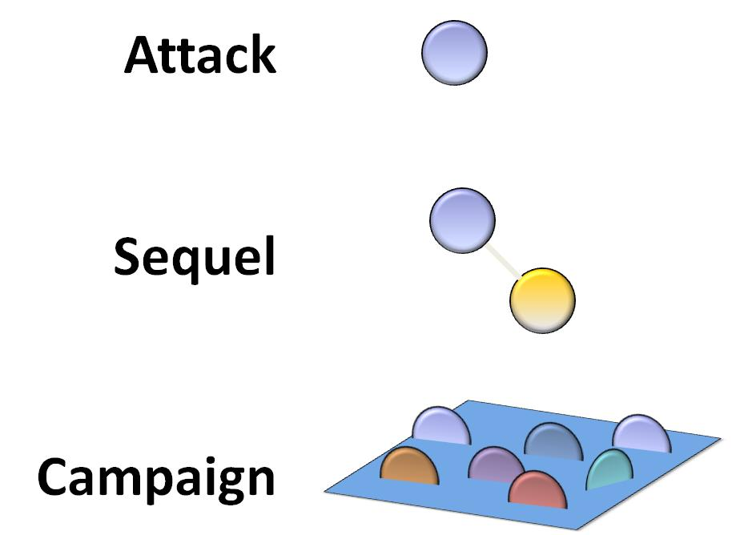
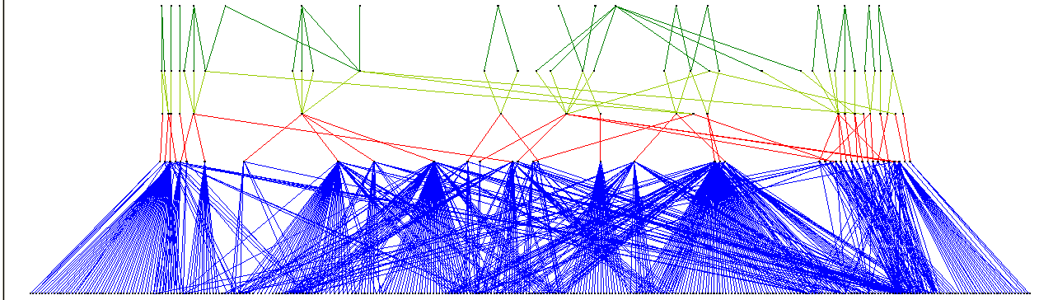
Campaign Scale Attacks
Phishing campaigns consist of multiple waves of targeted emails
  Different senders and different attachments, but same campaign
Attackers
C2 Servers

Slide 13
Targeting
Advanced threats targeted industry websites and portals
  Compromise “Waterholes” – Places where members of a particular industry tend to browse regularly
  Send links to spoofed websites to collect credentials/data
  Send links to web pages hosting malware
Same approach used in phishing email attacks
  Command & Control Functionality
  Exfiltration Capability
  Modified to be undetectable by Anti-Virus

Slide 14
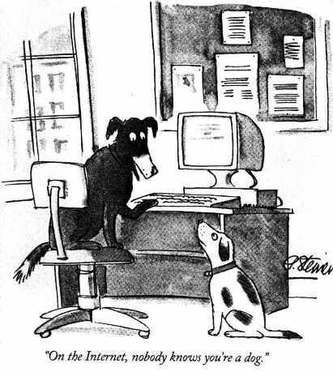
Trust
It has to be true!
I saw it on the Internet!
On the Internet, no one knows you’re a dog.
Risk=Threat x Vulnerability x Cost
Risk x (Threat + Vulnerability)= Compromise

Slide 15
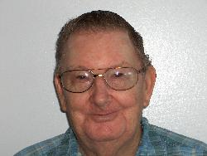
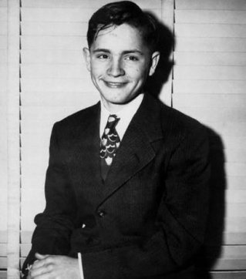
Trust
Not everyone is a good person…
Nice Person?
Risk x (Threat + Vulnerability)= Danger

Slide 16
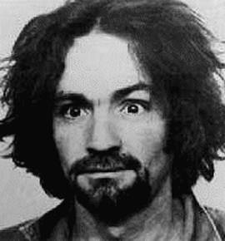
Trust
Not everyone is a good person…
Registered Sex Offender
SEXUAL ABUSE OF A MINOR
College Park MD
Charles Manson
Risk x (Threat + Vulnerability)= Danger

Slide 17
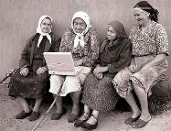
Responsibility
In the end, it all comes down to this:
  Cyber Security is everyone’s responsibility
  Be Informed!
  Get involved!
  Develop a Plan!

Slide 18
Responsibility
“The art of war teaches us to rely not on the likelihood of the enemy's not coming, but on our own readiness to receive him; not on the chance of his not attacking, but rather on the fact that we have made our position unassailable.”
Sun Tzu

Slide 19
The Future
Cyber Security is still in its infancy
Most solutions focus on endpoints and not a comprehensive mature process
Cyber programs tend to be ad hoc focusing on compliance rather than security (C&A= CYA)
Reactive rather than Proactive
Need to focus on the attacker, not the technique
We need more dedicated Cyber Security research professionals

Slide 20
Steve Lines, CISSP, CISA, CISM, CBCP
Director of Business Continuity and
Information Assurance
Office 256-971-6696 liness@saic.com
For More Information

